Slide 1


Slide 2


Building Better and More Often in Unity
Hi, I’m Jimbles
Occupation - XR Developer/ Human Swiss Army Knife
Employer - FLAIM Systems
Responsibilities - Editor Tooling, Systems Prototyping, Devops
Enjoys - The Beach, The Bush, The Couch
Coffee Order - Cappuccino
Cool Guy? - He thinks so
Twitter - @JimothyJimbles BlueSky - @jimjimbles.bsky.social
https://github.com/JimJimbles/BetterBuildsMoreOften

Slide 3
The Goal
Build more often with less downtime
Catch bugs before they bite you
Get Spun Up Quickly

Slide 4

Building From Script
- Writing c# code in unity to configure and fire off our builds without having to mess with the GUI
Writing Good Tests
- Overview of the capabilities of automated testing
Building Build Pipelines
- Setting up the steps that our automation server will run through to make our build
Special Sauce
-Getting Online
-Integrations with other services
-Cool Automations
The Game Plan
You’re gonna do WHAT?
Twitter - @JimothyJimbles BlueSky - @jimjimbles.bsky.social

Slide 5
Building from Script

Slide 6
Building from Script
In This Section
Not In This Section
Writing build scripts
Receiving custom arguments from the command line
Pre and Post build scripting
Unity CLI reference here: https://docs.unity3d.com/Manual/CommandLineArguments.html

Slide 7

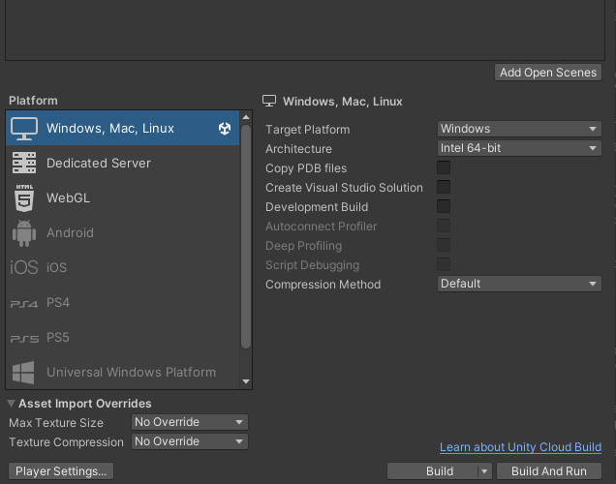
Building From Script

Slide 8
Quick Start
public class BuildScript
{
static void GenericBuild(string[] scenes, string target_dir, BuildTargetGroup buildTargetGroup, BuildTarget buildTarget, BuildOptions build_options)
{
EditorUserBuildSettings.SwitchActiveBuildTarget(buildTargetGroup, buildTarget);
BuildPlayerOptions buildPlayerOptions = new BuildPlayerOptions();
buildPlayerOptions.scenes = scenes;
buildPlayerOptions.locationPathName = target_dir;
buildPlayerOptions.target = buildTarget;
buildPlayerOptions.targetGroup = buildTargetGroup;
buildPlayerOptions.options = build_options;
BuildReport report = BuildPipeline.BuildPlayer(buildPlayerOptions);
BuildSummary summary = report.summary;
if (summary.result == BuildResult.Succeeded)
{
Debug.Log("Build succeeded: " + summary.totalSize + " bytes");
}
if (summary.result == BuildResult.Failed)
{
Debug.Log("Build failed");
}
}
}

Slide 9
static string[] Scenes = FindEnabledEditorScenes();
[MenuItem("Tools/Test CI Build")]
static void TestGenericBuild()
{
string target_dir = "C:/Builds/" + ProjectName + ".exe";
GenericBuild(Scenes, target_dir, BuildTargetGroup.Standalone, BuildTarget.StandaloneWindows64,
BuildOptions.None);
}

Slide 10

private static string[] FindEnabledEditorScenes()
{
List<string> EditorScenes = new List<string>();
foreach (EditorBuildSettingsScene scene in EditorBuildSettings.scenes)
{
if (!scene.enabled) continue;
EditorScenes.Add(scene.path);
}
return EditorScenes.ToArray();
}

Slide 11
public static void BashBuild()
{
var outputPath = GetCommandLineArg("customBuildPath");
var buildName = GetCommandLineArg("customBuildName");
string target_dir = Path.Combine(outputPath, buildName) + ".exe";
Debug.Log("Automated Build attempting to build to " + target_dir);
BuildPlayerOptions buildPlayerOptions = new BuildPlayerOptions();
buildPlayerOptions.scenes = Scenes;
buildPlayerOptions.locationPathName = target_dir;
buildPlayerOptions.target = EditorUserBuildSettings.activeBuildTarget; //In batch mode we can only compile for the target we've imported for
buildPlayerOptions.targetGroup = EditorUserBuildSettings.selectedBuildTargetGroup;
buildPlayerOptions.options = BuildOptions.None;
BuildReport report = BuildPipeline.BuildPlayer(buildPlayerOptions);
BuildSummary summary = report.summary;
}

Slide 12
Parameterise your builds!!
/// <summary>
/// Get the string value of a named command line argument passed to
/// the Unity editor.
/// </summary>
private static string GetCommandLineArg(string argName)
{
var args = Environment.GetCommandLineArgs();
for (var i = 0; i < args.Length; i++)
{
if (Regex.IsMatch(args[i], $"^-{argName}$") && i + 1 < args.Length)
{
return args[i + 1];
}
}
throw new Exception($"Could not find command-line argument \"{argName}\"");
}

Slide 13
Recap
Static editor functions can be called from the command line
Passing in custom parameters allows you to expand the capabilities of your automation
In batchmode build target is selected from the command line,

Slide 14
Testing

Slide 15
Testing
In This Section
Not In This Section
Unit Test Best Practices
Test vs Unity Test
Setting Up Test Runner - https://unity.com/how-to/automated-tests-unity-test-framework
Editor tests

Slide 16
F.I.R.S.T
Fast
Independent
Repeatable
Self-Validating
Thorough
Fast to execute
Does not rely on other systems
Must have consistent results
Clear pass or fail with no human interpretation
Test your functions with valid inputs and with invalid inputs.

Slide 17
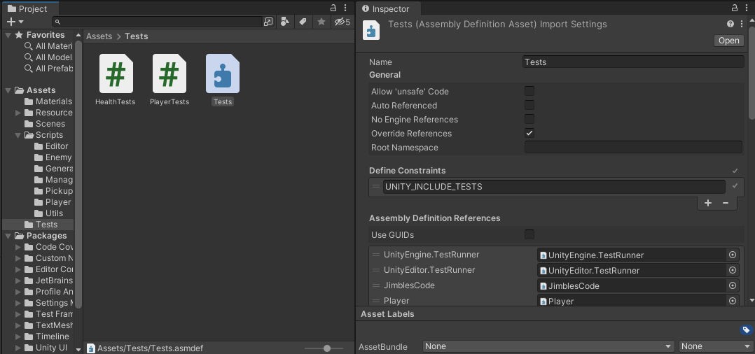
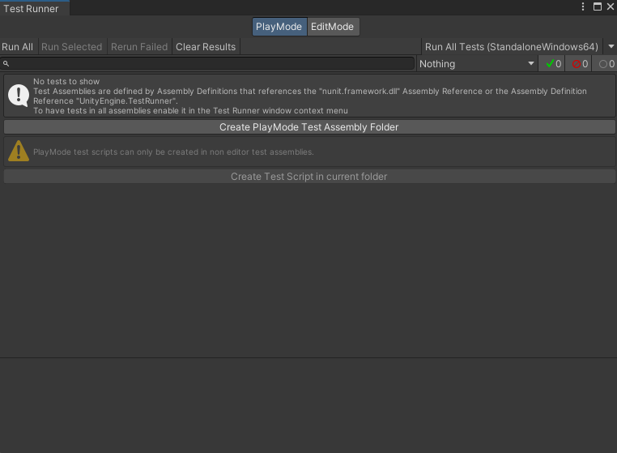
Getting Started

Slide 18
Example Time
public class Health : MonoBehaviour
{
public float maxHealth = 10f;
public float currentHealth { get; set; }
void Start()
{
currentHealth = maxHealth;
}
public void Heal(float healAmount)
{
float healthBefore = currentHealth;
currentHealth += healAmount;
currentHealth = Mathf.Clamp(currentHealth, 0f, maxHealth);
}
public void TakeDamage(float damage)
{
…
}
…etc
}

Slide 19
private GameObject testObject;
[SetUp]
public void SetUp()
{
testObject = GameObject.Instantiate(new GameObject());
testObject.AddComponent<Health>();
}
[TearDown]
public void TearDown()
{
GameObject.DestroyImmediate(testObject);
}
[Test]
public void TestHeal()
{
Health health = testObject.GetComponent<Health>();
health.maxHealth = 10f;
health.currentHealth = 2f;
health.Heal(2f);
Assert.That(health.currentHealth == 4f);
}
[Test]
public void TestOverHeal()
{
Health health = testObject.GetComponent<Health>();
health.maxHealth = 10f;
health.currentHealth = 2f;
health.Heal(20f);
Assert.That(health.currentHealth == 10f);
}

Slide 20
public class PlayerTests
{
private GameObject playerPrefab;
[OneTimeSetUp]
public void Setup()
{
playerPrefab = Resources.Load<GameObject>("Prefabs/Player");
}
[Test]
public void TestPlayerInstantiation()
{
GameObject playerObject = GameObject.Instantiate(playerPrefab, Vector3.zero, Quaternion.identity);
Assert.That(playerObject, !Is.Null);
}
[UnityTest]
public IEnumerator MoveLeft()
{
Vector3 playerPos = Vector3.zero;
Quaternion playerDir = Quaternion.identity; // the default direction the player is facing is enough
GameObject player = GameObject.Instantiate(playerPrefab, playerPos, playerDir);
player.GetComponent<PlayerController>().DoMovement(Vector3.left);
yield return new WaitForSeconds(1);
Assert.IsTrue(player.transform.position.x < playerPos.x);
}
}

Slide 21
Recap
Fast Tests let us test often
Independent tests help keep up from over coupling our code
Repeatable tests keep our code consistent
Self Validating tests alleviate the need to decipher debug log outputs
Thorough tests make it easier to remember what poorly commented functions are supposed to do

Slide 22





JENKINS
(and friends)

Slide 23
Unity Cloud Build?
wait… so why not
🐘

Slide 24
Unity Cloud Build?
Limited post-build actions
Unity Servers 🐢
Limited Debugability
Not all platforms
Longer builds = more $$$
wait… so why not

Slide 25
In This Section
Not In This Section
The Groovy Pipeline Introduction
Run the unity editor headlessly
Bash Scripts
Unity License Wrangling
Installing Jenkins - https://www.jenkins.io/doc/book/installing/
Installing Jenkins as a Windows Service - https://www.jenkins.io/doc/book/installing/windows/#invalid-service-logon-credentials
Installing Git - https://git-scm.com/

Slide 26
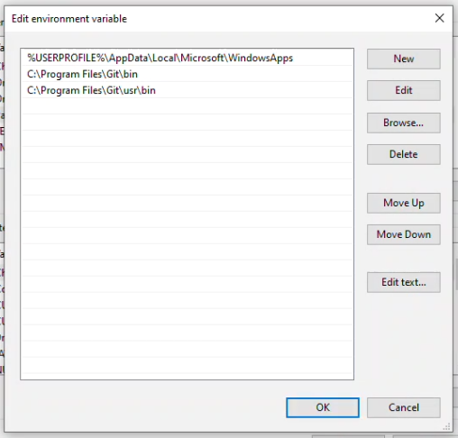
Pipelines
pipeline {
agent any
stages {
stage('Pull Git') {
steps {
checkout scm
}
}
stage('Test'){
steps{
sh './BuildAutomation/demoTest.sh'
}
}
stage('Build') {
steps {
sh './BuildAutomation/demoBuild.sh'
}
}
}
environment {
TIME = "${BUILD_TIMESTAMP}"
WORKSPACE = pwd()
BUILDS_DIR = 'C:\\Builds'
BUILD_METHOD = 'BuildScript.PerformWindowsCIBuild'
BRANCH = "${GIT_BRANCH.replaceFirst(/^.*\//, '')}"
SUB_DIR = "${BRANCH}${TIME}"
}
options {
disableConcurrentBuilds()
}
}

Slide 27
Pipeline
Pull Project From Git
Pull Project From Git
Send build start information to #Builds channel on slack
Run Unit Tests
Run Unit Tests
Build Project
Build Project
Zip build and upload to cloud
Send Pass/Fail information to #Builds slack channel

Slide 28
Let’s Bash
demoTest.sh
#!/bin/bash
TEST_PLATFORM=StandaloneWindows64
PROJECT_DIR=${WORKSPACE}
LOGFILE=$(mktemp)
"C:\Program Files\Unity\Hub\Editor\2021.3.18f1\Editor\Unity.exe" \
-logFile "$LOGFILE" -runTests -batchmode -nographics \
-projectPath $PROJECT_DIR -testResults "C:\\Builds\\results.xml" \
-testPlatform PlayMode &
unitypid=$!
tail -f -n +0 "$LOGFILE" &
tailpid=$! # Process ID of the most recently executed background pipeline (unity)
wait $unitypid # Wait for Unity to finish
UNITY_EXIT_CODE=$?
kill $tailpid # Kill tail now that Unity has finished writing log messages.
exit $UNITY_EXIT_CODE
-batchmode : suppresses pop-up windows that require human interaction
-nographics: Unity doesn’t initialize the graphics device
& starts the process in the background
$! contains the process ID of the most recently executed background pipeline
$? is used to find the return value of the last executed command

Slide 29
demoBuild.sh
#!/bin/bash
source ./BuildAutomation/local_find_unity.sh
export BUILD_TARGET=StandaloneWindows64
export BUILD_NAME="MyProject"
export PROJECT_DIR=${WORKSPACE}
export BUILD_METHOD="BuildScript.BashBuild"
export LOGFILE=$(mktemp)
./ci/build.sh
scriptsuccess=$?
wait
# Remove temp file
rm $LOGFILE
exit $scriptsuccess

Slide 30
export unity_version=$(sed -n 's/^\m_EditorVersion: //p'< ./ProjectSettings/ProjectVersion.txt)
echo "Found Unity version: $unity_version"
elif [[ "$OSTYPE" == "msys"* ]] && [ -z "$UNITY_EXECUTABLE" ]; then
unity_default_path="C:/Program Files/Unity/Hub/Editor/${unity_version}/Editor/Unity.exe"
if [ -f "${unity_default_path}" ]; then
export UNITY_EXECUTABLE="${unity_default_path}"
echo "Found 'UNITY_EXECUTABLE': '${UNITY_EXECUTABLE}'"
else
echo "Expected to find unity at '${unity_default_path}'. Please ensure Unity is installed and set 'UNITY_EXECUTABLE' env var to its location."
exit 1
fi

Slide 31
build.sh
#!/bin/bash
set -x
echo "Building for $BUILD_TARGET"
trap 'kill $(jobs -pr)' SIGINT SIGTERM
export BUILD_PATH=C:/Builds/$BUILD_TARGET/
mkdir -p $BUILD_PATH
# Being logged in to the unity hub with a valid license will work, if you're running on a machine that you can't log in with,
# you can activate with a manual activation file like this https://docs.unity3d.com/Manual/ManualActivationCmdWin.html
"${UNITY_EXECUTABLE}" -projectPath $PROJECT_DIR -quit -batchmode -nographics -buildTarget $BUILD_TARGET \
-customBuildName $BUILD_NAME \
-customBuildPath $BUILD_PATH \
-executeMethod $BUILD_METHOD \
-logFile "$LOGFILE" &
unitypid=$! # Process ID of the most recently executed background pipeline (unity)
tail -f -n +0 "$LOGFILE" &
tailpid=$!
wait $unitypid # Wait for Unity to finish
unityreturn=$?
ls -la $BUILD_PATH
[ -n "$(ls -A $BUILD_PATH)" ] # fail job if build folder is empty
kill $tailpid # Kill tail now that Unity has finished writing log messages.
wait # wait until all processes from this script have finished themselves
# Remove temp file
rm $LOGFILE
exit $unityreturn
SIGINT - Signal Interrupt
SIGTERM - Signal Terminate

Slide 32
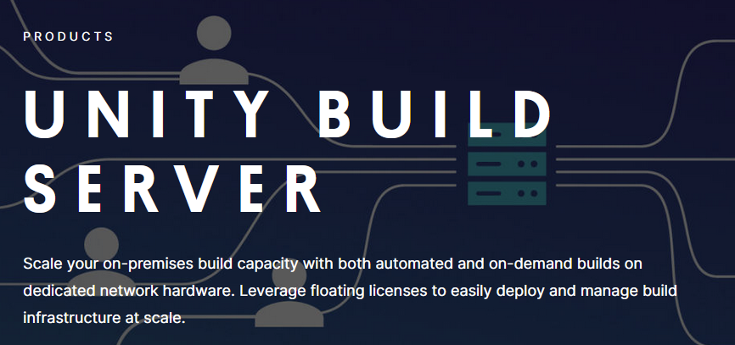
Unity Licensing
Register
"<editor-installation-location>" -batchmode -username name@example.com -password XXXXXXXXXXXXX -serial E3-XXXX-XXXX-XXXX-XXXX-XXXX -quit
Release
"<editor-installation-location>" -quit -batchmode -returnlicense -username name@example.com -password XXXXXXXXXXXXX

Slide 33
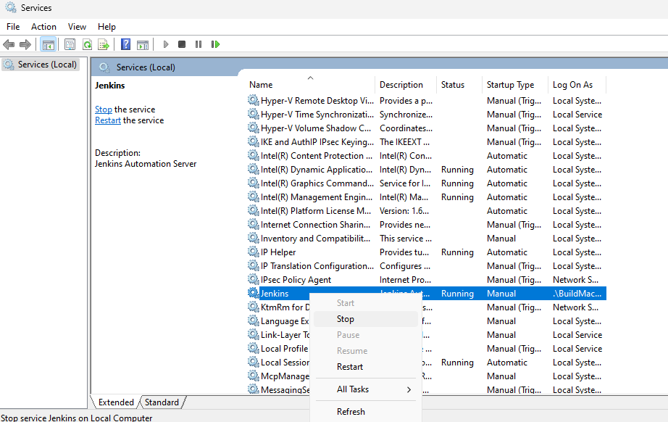
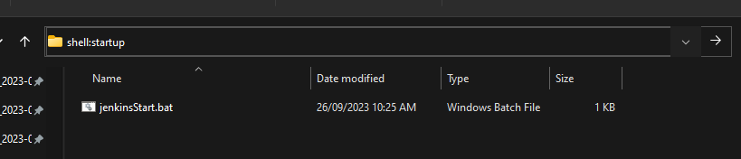

Arcane Knowledge

Slide 34
Recap
CI Tools are just interfaces for executing scripts
The groovy pipeline is just the glue between scripts
Find the balance between manual work and automation
(Windows) - Jenkins as an automatic service may fail when compiling shaders. Launch from a bat file on startup instead.

Slide 35
Extra Special Sauce
Getting Online
Git Hooks
Listen to the repo and build on update
Slack Integration
Post build progress notifications to a slack channel
Send a command on a slack channel to trigger a build of a specific branch/commit
More cleanup
Zip the build up once it’s done so it takes up less hard drive space (7Zip has a CLI version that comes in really handy
Cache the library folder to speed up import times/set up a unity accelerator server
Oauth Login through github or google instead of Jenkins Account

Slide 36

Getting Online
ngrok http --domain=my-static-domain.ngrok-free.app 8080
%localappdata%\ngrok\ngrok.yml
version: "2"
authtoken: lmaoyourenotgettingmytoken
tunnels:
jenkins:
proto: http
addr: 8080
schemes: [https]
domain: my-static-domain.ngrok-free.app
ngrok service install --config %localappdata%\ngrok\ngrok.yml

Slide 37
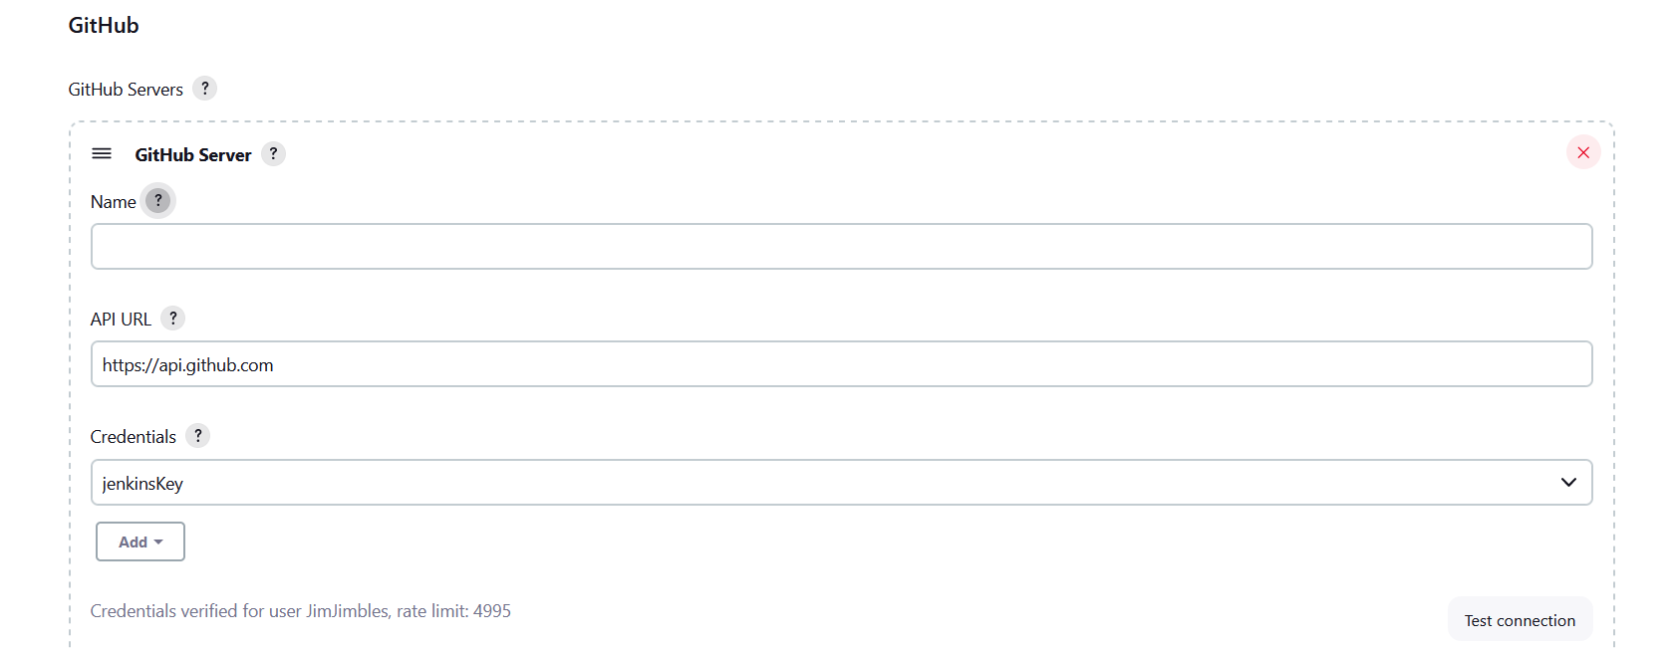
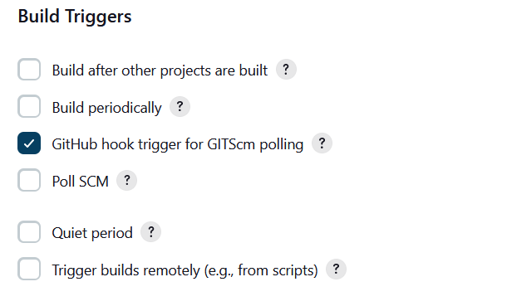
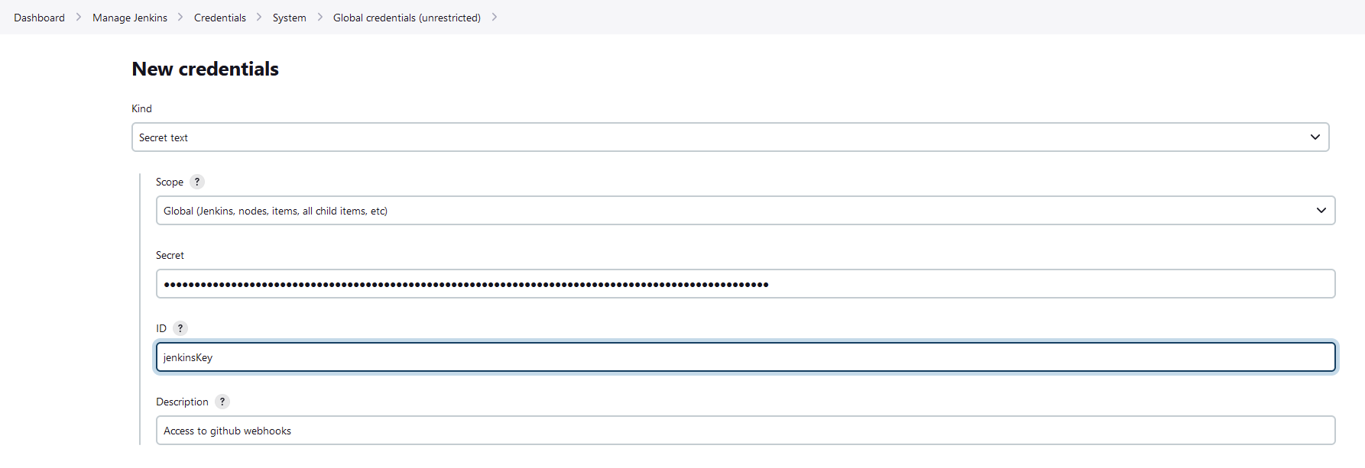
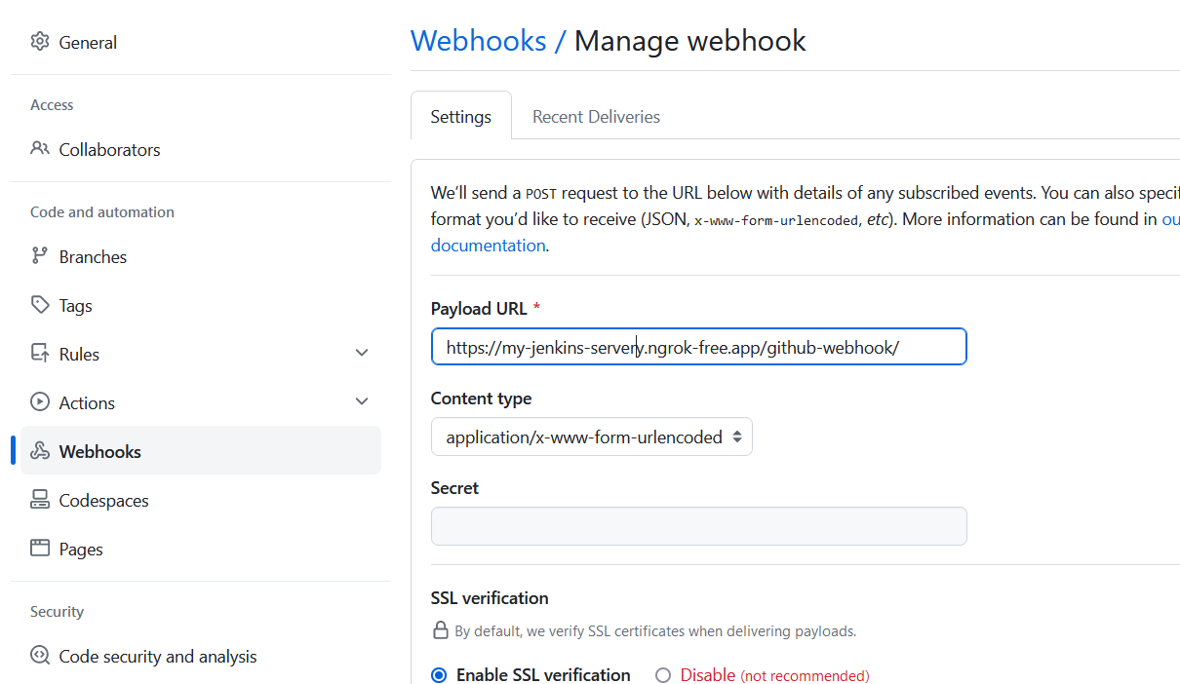
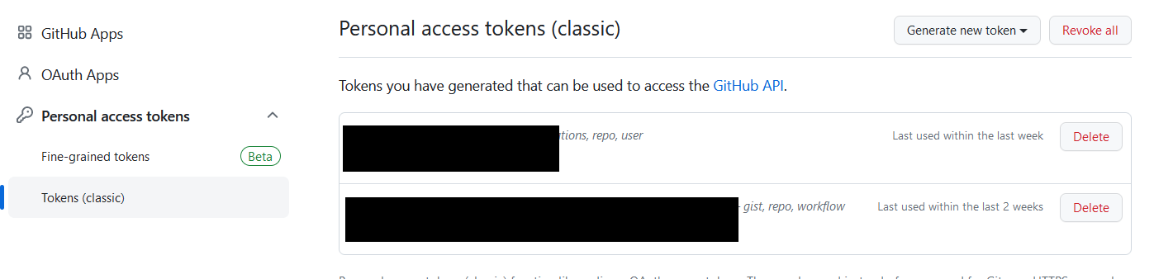
Git hooks
https://github.com/settings/tokens

Slide 38
Cleanup
stage('Cleanup') {
steps {
bat """
"${ZIP_EXE}" a "${CLOUDFOLDER}\\${BUILD_TARGET}\\${BUILD_NAME}${TIME}.zip" "${BUILD_PATH}"
"""
bat """
rmdir /s /q "${BUILD_PATH}"
"""
}
}
environment {
CLOUDFOLDER = "C:\\CloudFolder\\Builds"
TIME = "${BUILD_TIMESTAMP}"
WORKSPACE = pwd()
BUILD_TARGET='StandaloneWindows64'
BUILD_NAME="MyProject"
BUILDS_DIR = 'C:\\Builds'
BUILD_PATH="${BUILDS_DIR}\\${BUILD_TARGET}\\${BUILD_NAME}${TIME}"
BUILD_METHOD="BuildScript.BashBuild"
BRANCH = "${GIT_BRANCH.replaceFirst(/^.*\//, '')}"
SUB_DIR = "${BRANCH}${TIME}"
ZIP_EXE = "C:\\Program Files\\7-Zip\\7z.exe"
UNITY_VER = "C:\\Program Files\\Unity\\Hub\\Editor\\2021.3.18f1\\Editor\\Unity.exe"
}

Slide 39
Slack
https://api.slack.com/
https://plugins.jenkins.io/slack/
stage('Begin') {
steps {
script{
def attachments = [
[
text: "Building ${BRANCH}",
fallback: 'Build Started',
color: '#e5f3ff'
]
]
slackSend(channel: '#myChannel” attachments: attachments)
}
}
}
post {
failure {
script{
def attachments = [
[
text: "Build ${BRANCH}${TIME} on branch ${BRANCH} failed :cutom_emoji:",
fallback: 'Build Failed',
color: '#dd1100'
]
]
slackSend(channel: '#buildChannel', attachments: attachments)
}
}
}
post supports: always, changed, fixed, regression, aborted, failure, success, unstable, unsuccessful, and cleanup

Slide 40
Questions?

